Slide 1
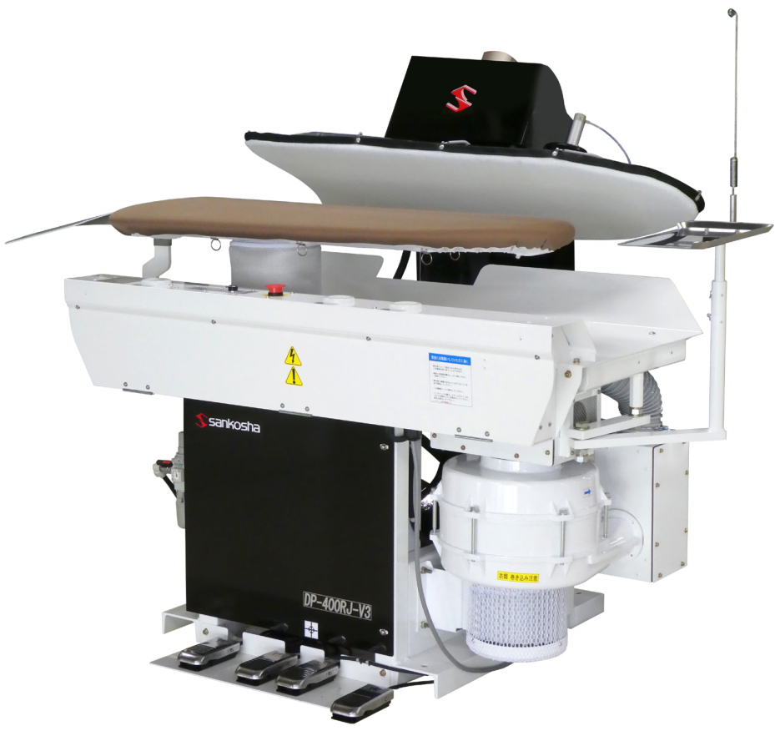
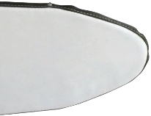
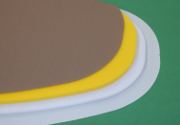
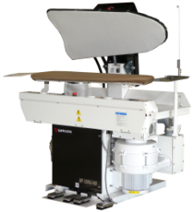
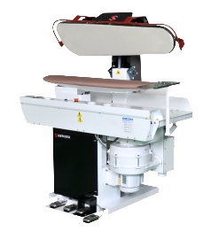
Sankosha – The Versatile Gear
Cutting-edge Legger Finisher
■ World Standard of
Finishing Quality
Second-to-none quality finishing by
industry innovator
■ Selection of Your
Favorite Finishing
Choice of sharp/soft creases, steam
pumping or puff function
■ High Productivity
with Power
Up to 70 quality finishing per hour
by 1 person
■ Fast-back Upper Press
. You can widely make use of the lower buck
without crouching or dodging the upper press
DP-450RE-v3
Fast-back Legger Press
Specifications
Secret of Quality Finish
Grid Plate
Live Steam Diffuser
Multi-layer Lower Buck
Lower Buck Size
DP-420TE
Utility Press
475
340
DP-610TE
Legger Press
http://www.sankosha-mfg.com
Visit our web site for valuable Information for your business expansion.
1160
SANKOSHA MANUFACTURING CO., LTD.
988 Kanoya, Hachioji, Tokyo 193-0815, Japan
Tel: +81 42 621 1182 Fax: +81 42 620 0751

